Slide 1

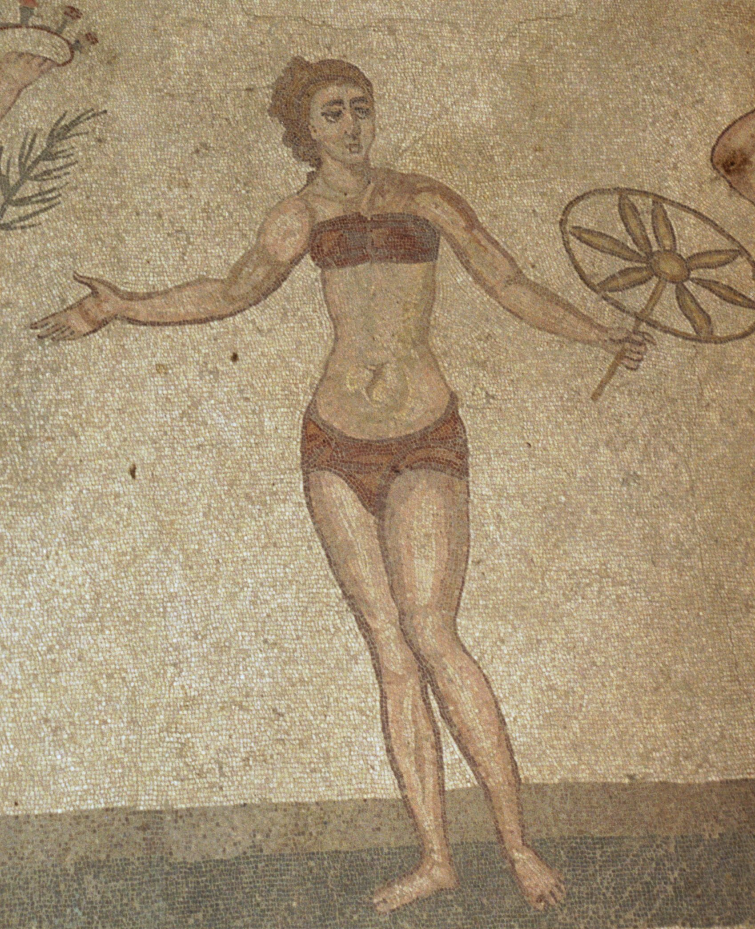
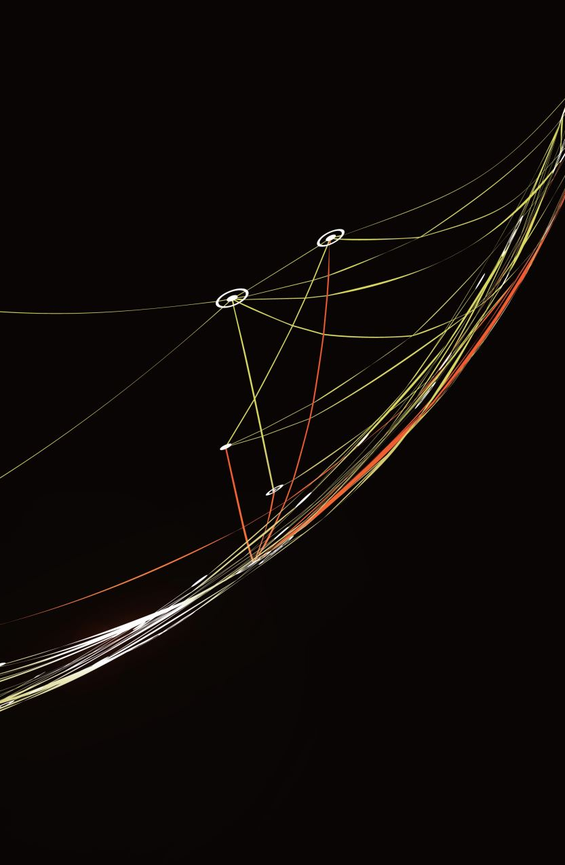
Learn Sicilian/ Mparamu lu Sicilanu
An Interactive course with Professor Gaetano Cipolla
Lesson 2

Slide 2

Lessons 2
Instructor: In the previous lesson you learned about the two conjugations of Sicilian verbs. The infinitives end in ari and iri (parrari and scriviri). You learned the first two persons of the verb vuliri (to want) (vogghiu and voi). In this lesson you are going to learn the plural forms of the verbs in ari and iri as well as the full present tense of vuliri and the subject pronouns. Let’s review:
Instructor: Do you recall how to ask the question “What do you want to do?” Yes of course. It’s Chi voi fari? Do you recall how to answer the question: “Pirchi voi mparari lu sicilianu?”
Student:Vogghiu mparari lu sicilianu pirchi vogghiu parrari cu me nannu.”
Intructor: Bravu! Voi scriviri a to nannu in sicilianu?
Student: Si, vogghiu scriviri a me nannu in sicilianu.
Instructor: Bravu! Voi mparari lu giappunisi o lu sicilianu?
Student: Vogghiu mparari lu sicilianu. Non vogghiu mparari lu giappunisi.

Slide 3
Instructor: Now if you are talking to more than one person you must change the verb to the plural, thus chi voi fari becomes Chi vuliti fari? Repeat: Chi vuliti fari? Now ask me and my imaginary friend next to me “What do you want to do?”:
Student: Chi vuliti fari?
Instructor. Vulemu mparari lu sicilianu (We want to learn Sicilian) Repeat the answer.
Student: Vulemu mparari lu sicilianu.
Instructor: Vuliti mparari lu sicilianu o lu francisi?
Student: Vulemu mparari lu sicilianu.
Instructor: Vuliti scriviri in sicilianu?
Student: Si, vulemu scriviri in siciliano.
Instructor: Vuliti mparari lu giappunisi?
Student: No, non vulemu mparari lu giappunisi. Vulemu mparari lu sicilianu.

Slide 4
Instructor: Bravu! Now let’s listen to a little conversation between Maria and Mariu. Introduce the audio for the conversation:
Conversation between Maria and Mariu:
Mariu Voi mparari lu sicilianu?
Marìa Sì, certu ca vogghiu mparari lu sicilianu e tu?
Mariu Io puru vogghiu mparari lu sicilianu.
Marìa Picchì voi mparari lu sicilianu?
Mariu Picchì vogghiu parrari sicilianu cu me nannu. (with my grandfather)
Marìa Allura picchì nun mparamu lu sicilianu nzemmula? (So, why don’t we learn together?)
Mariu Certu, cu piaciri. (Of course, with pleasure)

Slide 5
Instructor: Can you guess what this means? Chi voli fari Maria? Of course. It means “What does Mary want to do?”
Instructor: Comu si dici (how do you say?) Maria wants to learn Sicilian.
Student: Maria voli mparari lu sicilianu.
Instructor: Bravu! Voli is the third person singular of the verb vuliri in the present tense. It means she wants, but also he wants. Now what do you suppose I am asking when I say, Chi vonnu fari Maria e Mariu?
Student: What do Maria and Mariu want to do?
Instructor: This is the third person plural of the verb: (they want) Let’s repeat the questions: Chi voli fari Maria? Chi vonnu fari Maria e Mariu?
Instructor: Now listen to the conversation again and answer the questions on the next slide:

Slide 6
Instructor: Maria voli mparari lu sicilianu?
Student: Si, certu ca Maria voli mparari lu sicilianu
Instructor: Puru Mariu voli mparari lu sicilianu?
Student: Si, puru Mariu voli mparari lu sicilianu
Instructor: Pirchi Mariu voli mparari lu sicilianu?
Student: Mariu voli mparari lu sicilianu pirchi voli parrari cu so nannu.
Instructor: Cu (who) voli parrari sicilianu cu so nannu, Mariu o Maria?
Student: Mariu voli parrari sicilianu cu so nannu.
Instructor: Mariu voli mparari lu sicilianu nzemmula (together) cu Maria?
Student: Si, Mariu voli mparari lu sicilianu nzemmula cu Maria.

Slide 7
Instructor: In Sicilian the verb forms contain information about the subject pronoun. Thus, vogghiu can only mean I want, voi can only mean you want, vulemu we want, vuliti you want, vonnu they want. The third person ending can mean he or she and the third plural means they, which in Sicilian is the same for both masculine and feminine. Therefore, it’s not necessary to use the subject pronouns unless you want to put emphasis on them. So, now we have the full conjugation of the verb vuliri in the present tense. What are the forms that we learned? Let’s review them nzemmula. Repeat after me:
Vogghiu, voi, voli, vulemu, vuliti, vonnu. What are the subject pronouns that are associated with these forms?
Io, tu, iddu, idda, nui, vui, iddi. Now connect the subject pronoun with the correct verb form:
Instructor: Vogghiu . Student: io vogghiu
Instructor: voi Student: tu voi
Instructor: voli Student: iddu voli, or idda voli
Instructor: vulemu Student: Nui vulemu
Instructor: vuliti Student: vui vuliti
Instructor: vonnu Student: Iddi vonnu

Slide 8
Instructor: The first person pronoun is different depending on where you are in Sicily: These are the forms you may hear: Eu, (Palermo) iu, (pronounced as the English You) in Catania, io (pronounced as yoh) in Messina province and iu, in other parts and in some places you may even hear i for I.
Now connect the subject pronouns with the correct form of Vuliri in the Present tense::
Instructor: io Student: io vogghiu
Instructor: tu Student: tu voi
Instructor: iddu Student: iddu voli
Instructor: idda Student: idda voli
Instructor: nui Student: nui vulemu
Instructor: vui Student: vui vuliti
Instructor: iddi Student: iddi vonnu

