Slide 1

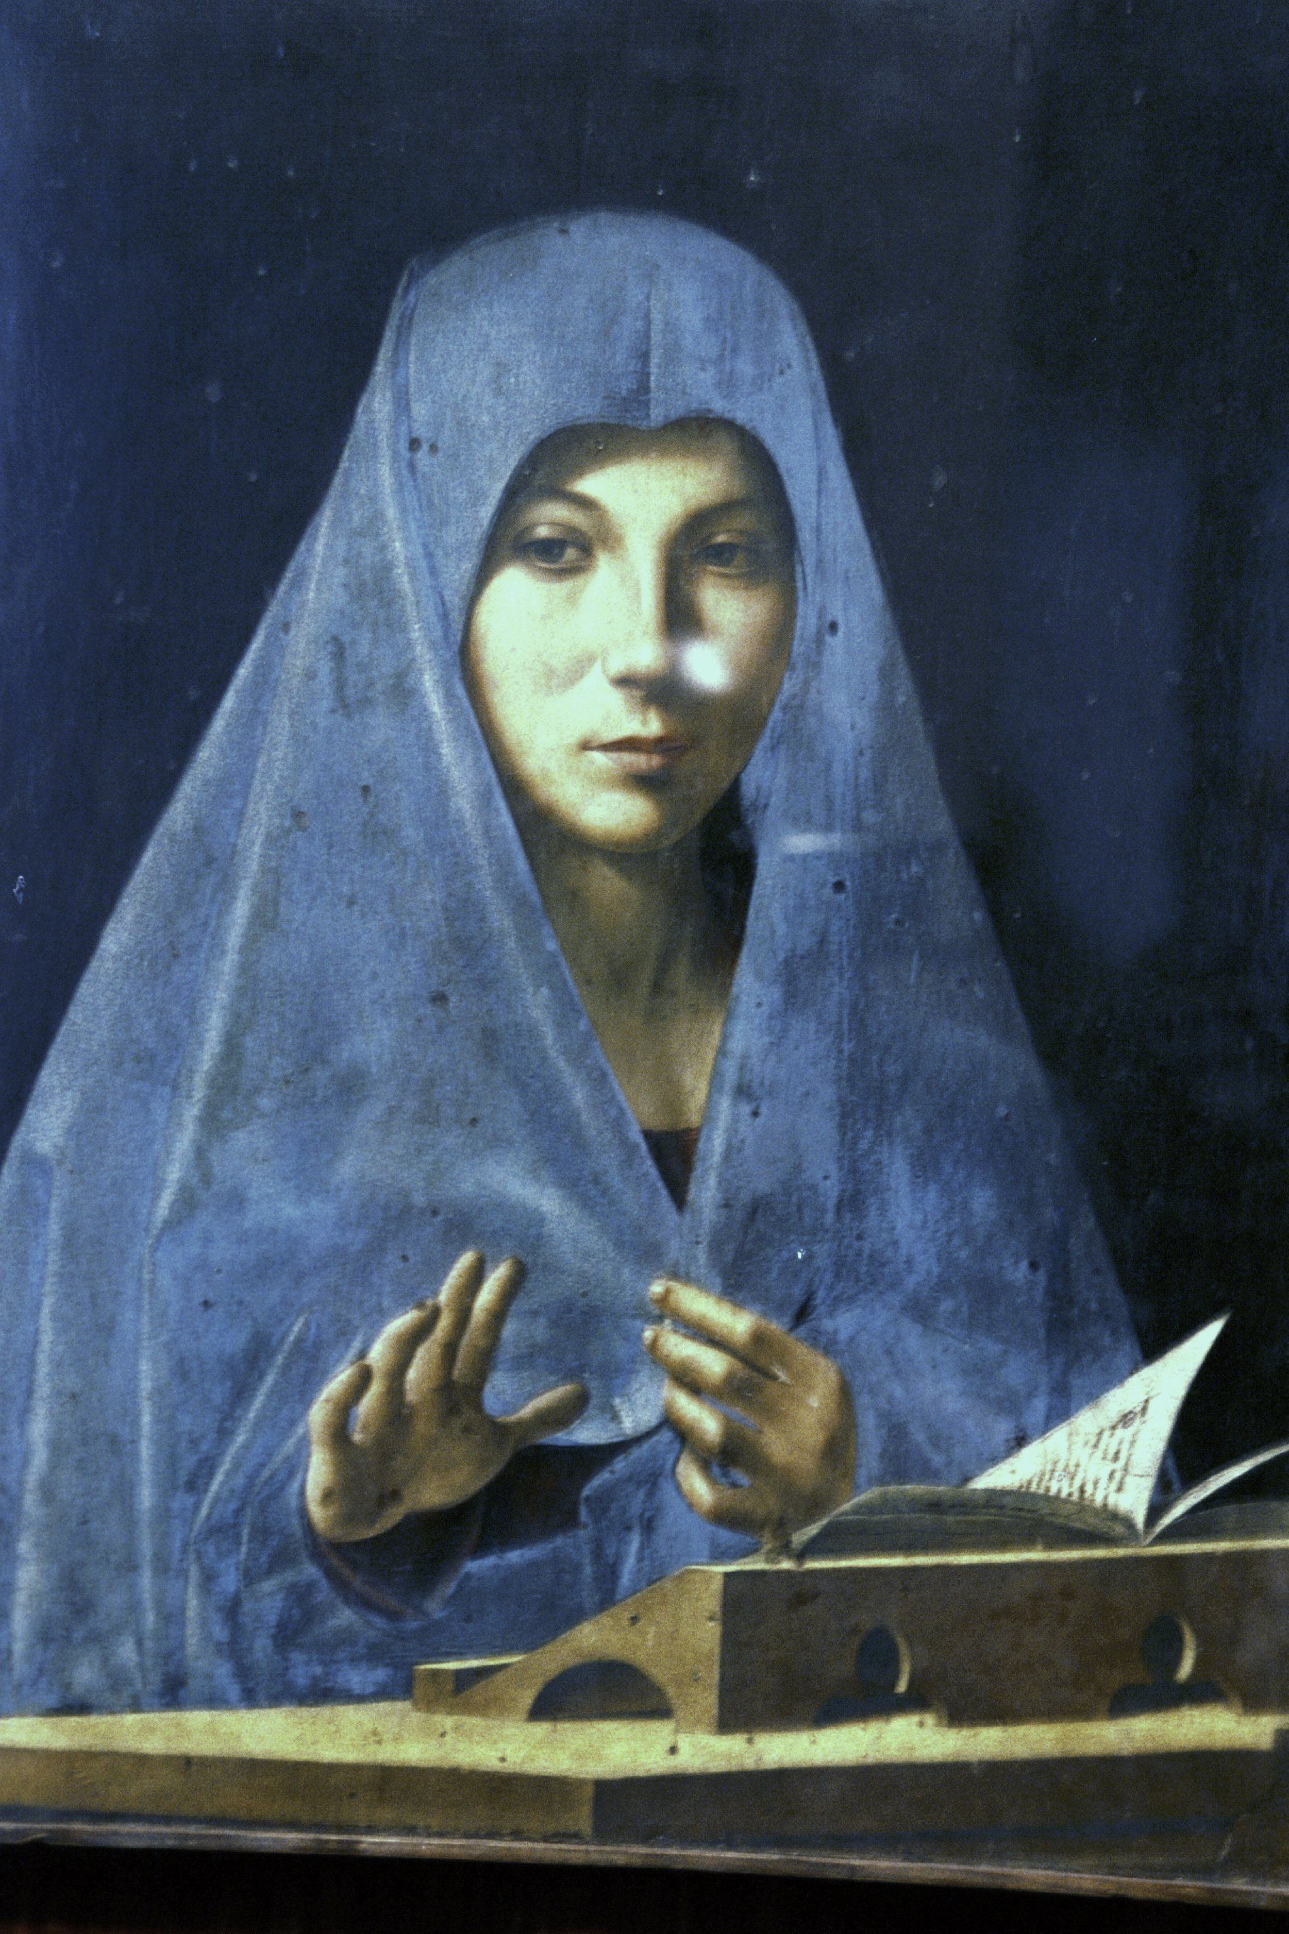
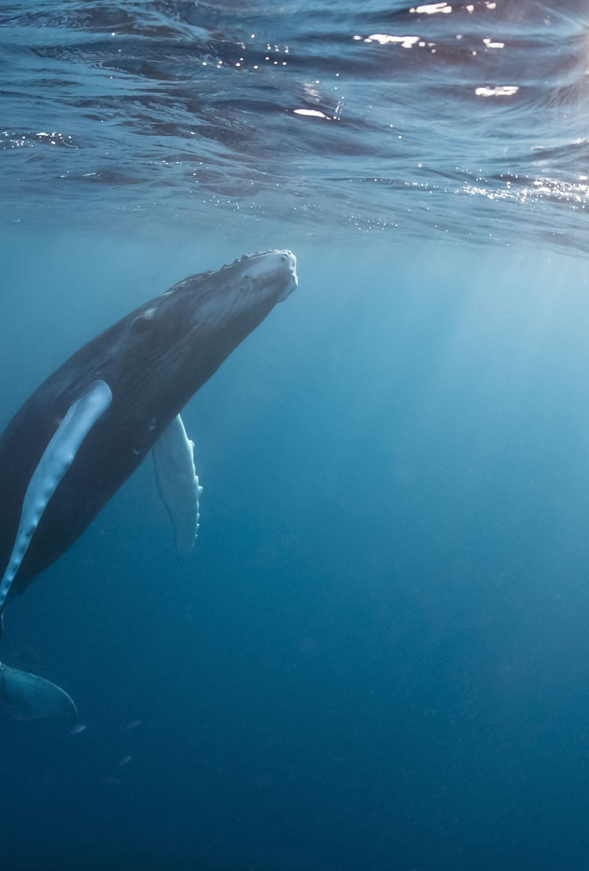
Learn Sicilian/Mparamu lu sicilianu
Interactive Lessons
with Professor Gaetano Cipolla
Lesson I

Slide 2

Lesson I
In this lesson you will learn that Sicilian has two categories of verbs, those that end in ari like parrari, (to speak) and mparari (to learn), and those that end in iri like scriviri (to write) and rispunniri (to answer).
You will also learn the first two persons of the verb vuliri (to want) in the present tense: Vogghiu (I want) and voi (you want). The verb vuliri is a useful verb because you can combine it with the infinitive of other verbs and you can form dozens of sentences like “I want to learn Sicilian, I want to take a walk, you want to write in Sicilian” etc.
You will also learn how to formulate questions and how to answer in the affirmative and in the negative form.
Please listen to the instructions and try to answer the questions by imitating the instructor’s pronunciation. Let’s begin!

Slide 3
This is an interactive exercise. I will play the part of the instructor, and as you are not here, I will play your part as well, leaving some time for you to answer. You should use my answers to check your pronunciation.
Let’s start with a question: What do you want to do? Chi voi fari?
Repeat after me: Chi voi fari? Again, Chi voi fari? Now ask me “What do you want to do?”
Student: Chi voi fari?
Instructor: Vogghiu mparari lu sicilianu. (I want to learn Sicilian.) Please repeat: Vogghiu mparari lu sicilianu.
Student: Vogghiu mparari lu sicilianu.
Instructor: Now I will ask you: Chi voi fari?
Student: Vogghiu mparari lu sicilianu.
Instructor: Bravu! (Excellent) In Sicilian the sentence voi mparari lu sicilianu simply means “You want to learn Sicilian.” To turn the sentence into a question all you need to do is change the intonation as follows: voi mparari lu sicilianu? It would help if you lean to the right as you ask the question: voi mparari lu sicilianu? Try it!

Slide 4
Instructor: now ask me the question: voi mparari lu sicilianu? Do you want to learn Sicilian?
Student: voi mparari lu sicilianu?
Instructor: si, vogghiu mparari lu sicilianu. Please repeat after me: si, vogghiu mparari lu sicilianu. Now if you don’t want to learn Sicilian, just put non before the first verb: Ask me again if I want to learn Sicilian.
Student: voi mparari lu sicilianu?
Instructor: no, non vogghiu mparari lu sicilianu. Repeat after me: no, non vogghiu mparari lu sicilianu.
Instructor: Let’s learn a few more verbs. Ask me What do you want to do?
Student: Chi voi fari?
Instructor: Vogghiu parrari sicilianu. I want to speak Sicilian. Repeat it after me:
Student: Vogghiu parrari sicilianu.
Instructor: Voi parrari sicilianu? Answer affirmatively!

Slide 5
Student: Si, vogghiu parrari sicilianu.
Instructor: Voi parrari giappunisi? Answer negatively!
Student: No, non vogghiu parrari giappunisi.
Instructor: Voi parrari francisi? Answer negatively and tell me what you want to speak!
Student: No, non vogghiu parrari francisi. Vogghiu parrari sicilianu.
Instructor: Ask me “What do you want to do?”
Student: Chi voi fari?
Instructor: Vogghiu scriviri in sicilianu. I want to write in Sicilian. Repeat please.
Student: Vogghiu scriviri in sicilianu.
Instructor: Voi scriviri in sicilianu? Do you want to write in Sicilian?
Student: Si, vogghiu scriviri in sicilianu.

Slide 6
Instructor: Voi rispunniri in sicilianu? (rispunniri to answer)
Student: Si, vogghiu rispunniri in sicilianu.
Instructor: Voi rispunniri in francisi? Answer no and tell me how you want to answer.
Student: No, non vogghiu rispunniri in francisi. Vogghiu rispunniri in sicilianu.
Instructor: A more complex question: Pirchi voi mparari lu sicilianu? Why do you want to learn Sicilian? Repeat the question!
Student: Pirchi voi mparari lu sicilianu?
Instructor: Vogghiu mparari lu sicilianu pirchi vogghiu parrari cu me nannu. I want to learn Sicilian because I want to speak with my grandfather. Repeat please.
Student: Vogghiu mparari lu sicilianu pirchi vogghiu parrari cu me nannu.
Instructor: Voi mparari lu sicilianu pirchi voi parrari cu to nannu? Do you want to learn Sicilian because you want to talk with your grandfather?
Student: Si, vogghiu mparari lu sicilianu pirchi vogghiu parrari cu me nannu.

Slide 7
Instructor: Here are a few questions you should be able to answer correctly:
1. Chi lingua voi mparari? Vogghiu mparari lu sicilianu.
2. Voi mparari lu francisi? No, non vogghiu mparari lu francisi.
3. Voi scriviri in giappunisi? No, non vogghiu scriviri in giappunisi.
4. Pirchi voi mparari lu sicilianu? Vogghiu mparari lu sicilianu pirchi vogghiu parrari cu me nannu.
5. Voi parrari sicilianu cu to nannu? Si, vogghiu parrari sicilianu cu me nannu.

